Slide 1
Under Standing Elementary Shape
Class VI

Slide 2
HOW TO MESURE LINE SEGMENTS
COMPARISON BY OBSERVATION
COMPARISON BY TRACING
COMPARISON BY USING RULER AND DIVIDER

Slide 3
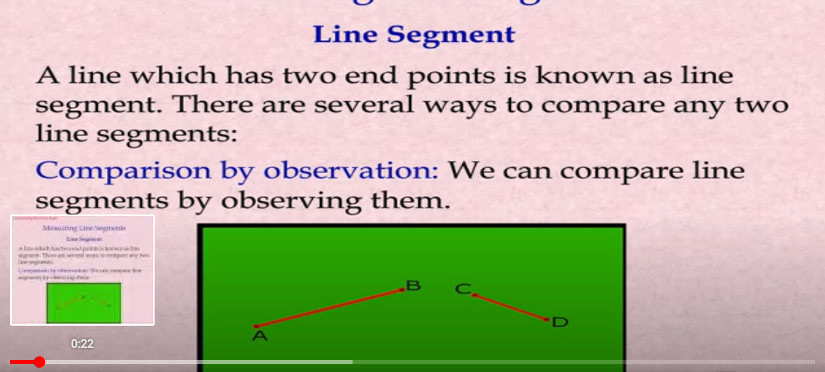
COMPARISON BY OBSERVATION

Slide 4
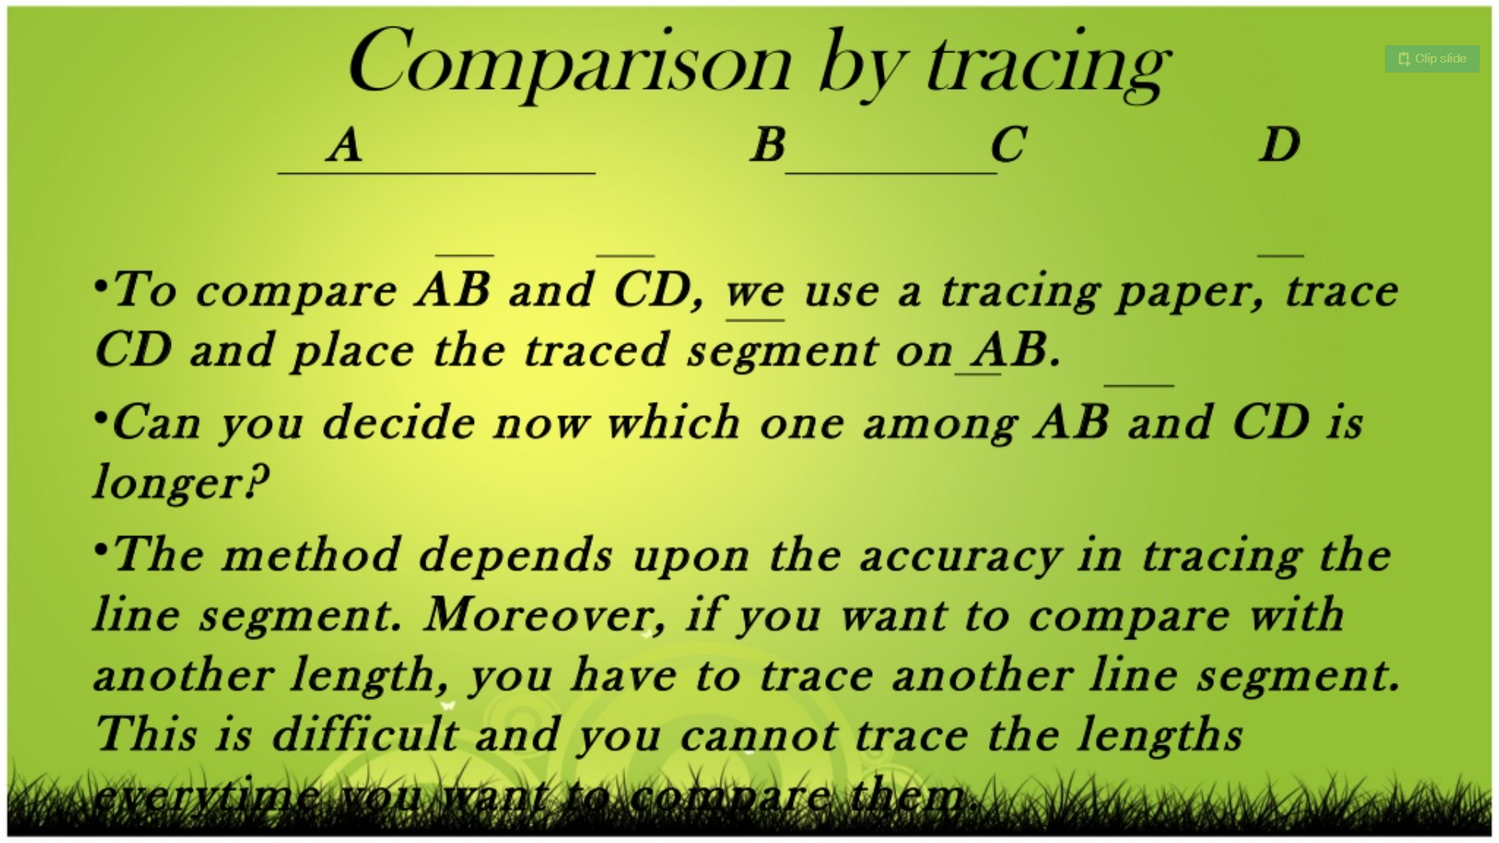
COMPARISON BY TRACING

Slide 5
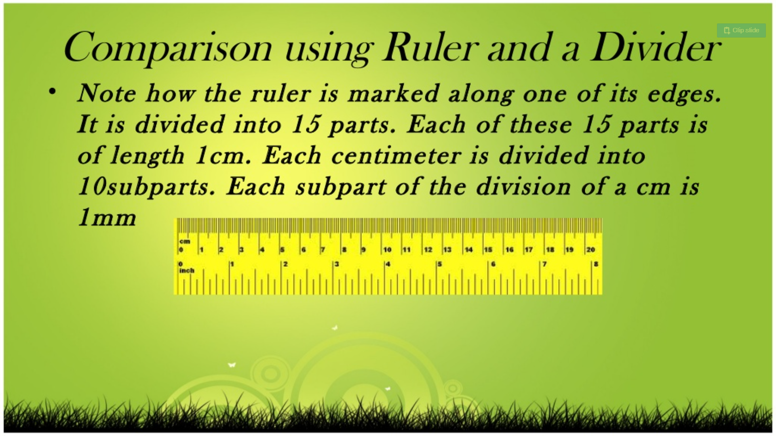
COMPARISON BY RULER AND DIVIDER

Slide 6
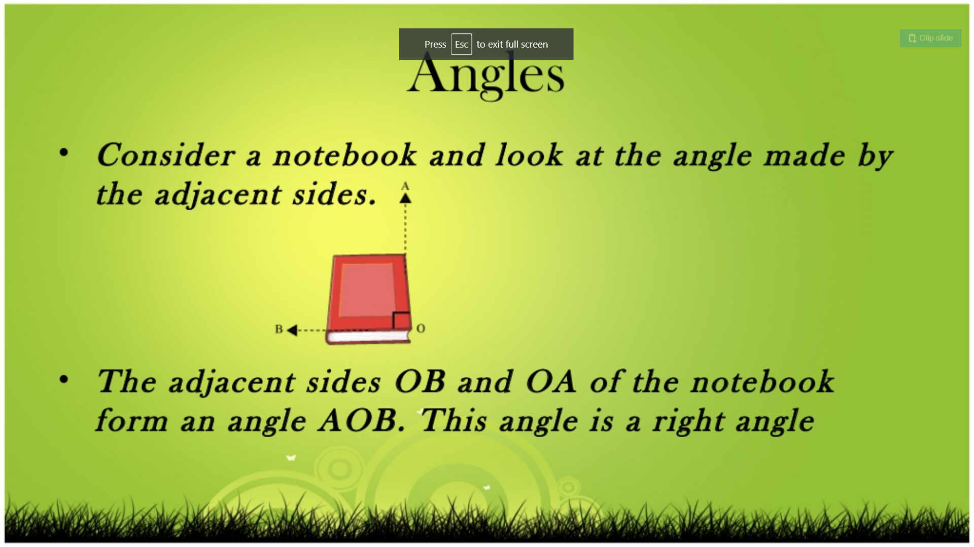
MEASURING OF ANGLE

Slide 7
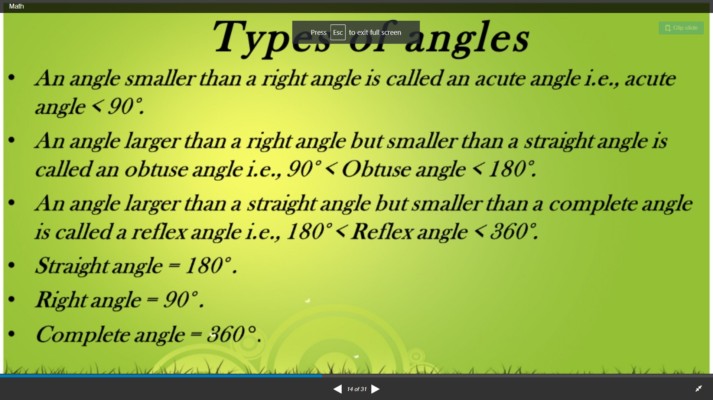

Slide 8
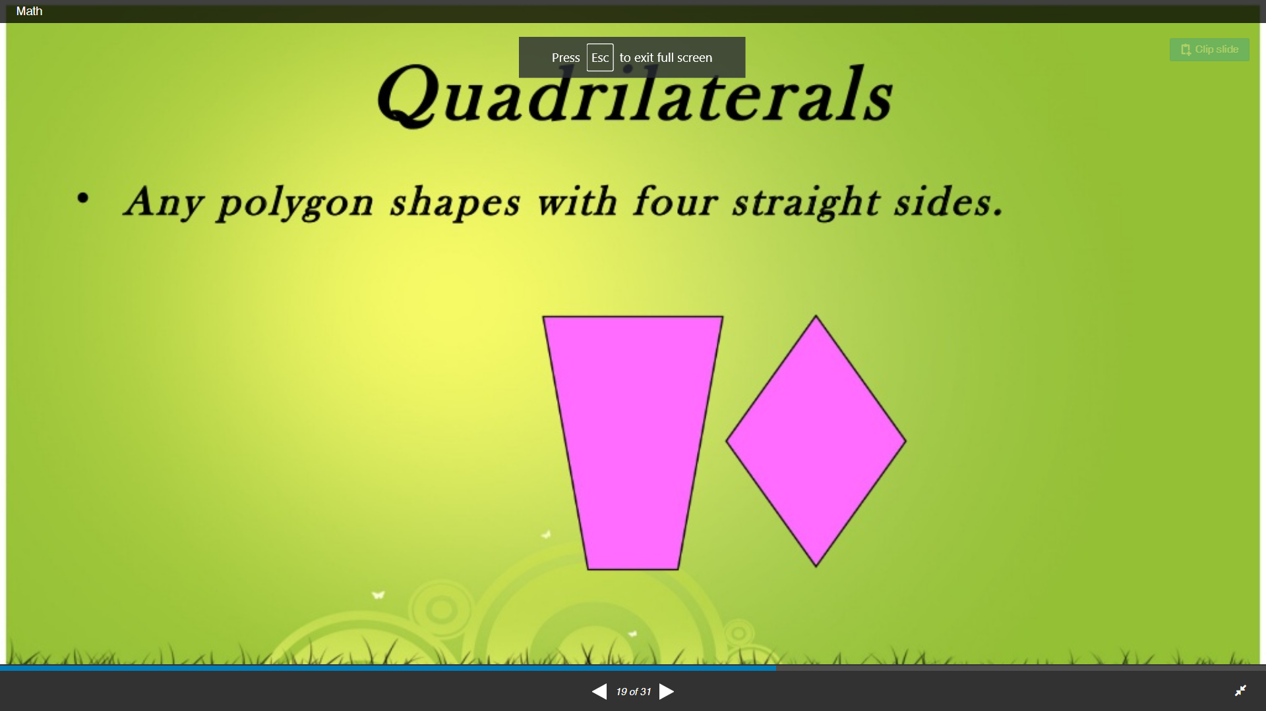

Slide 9
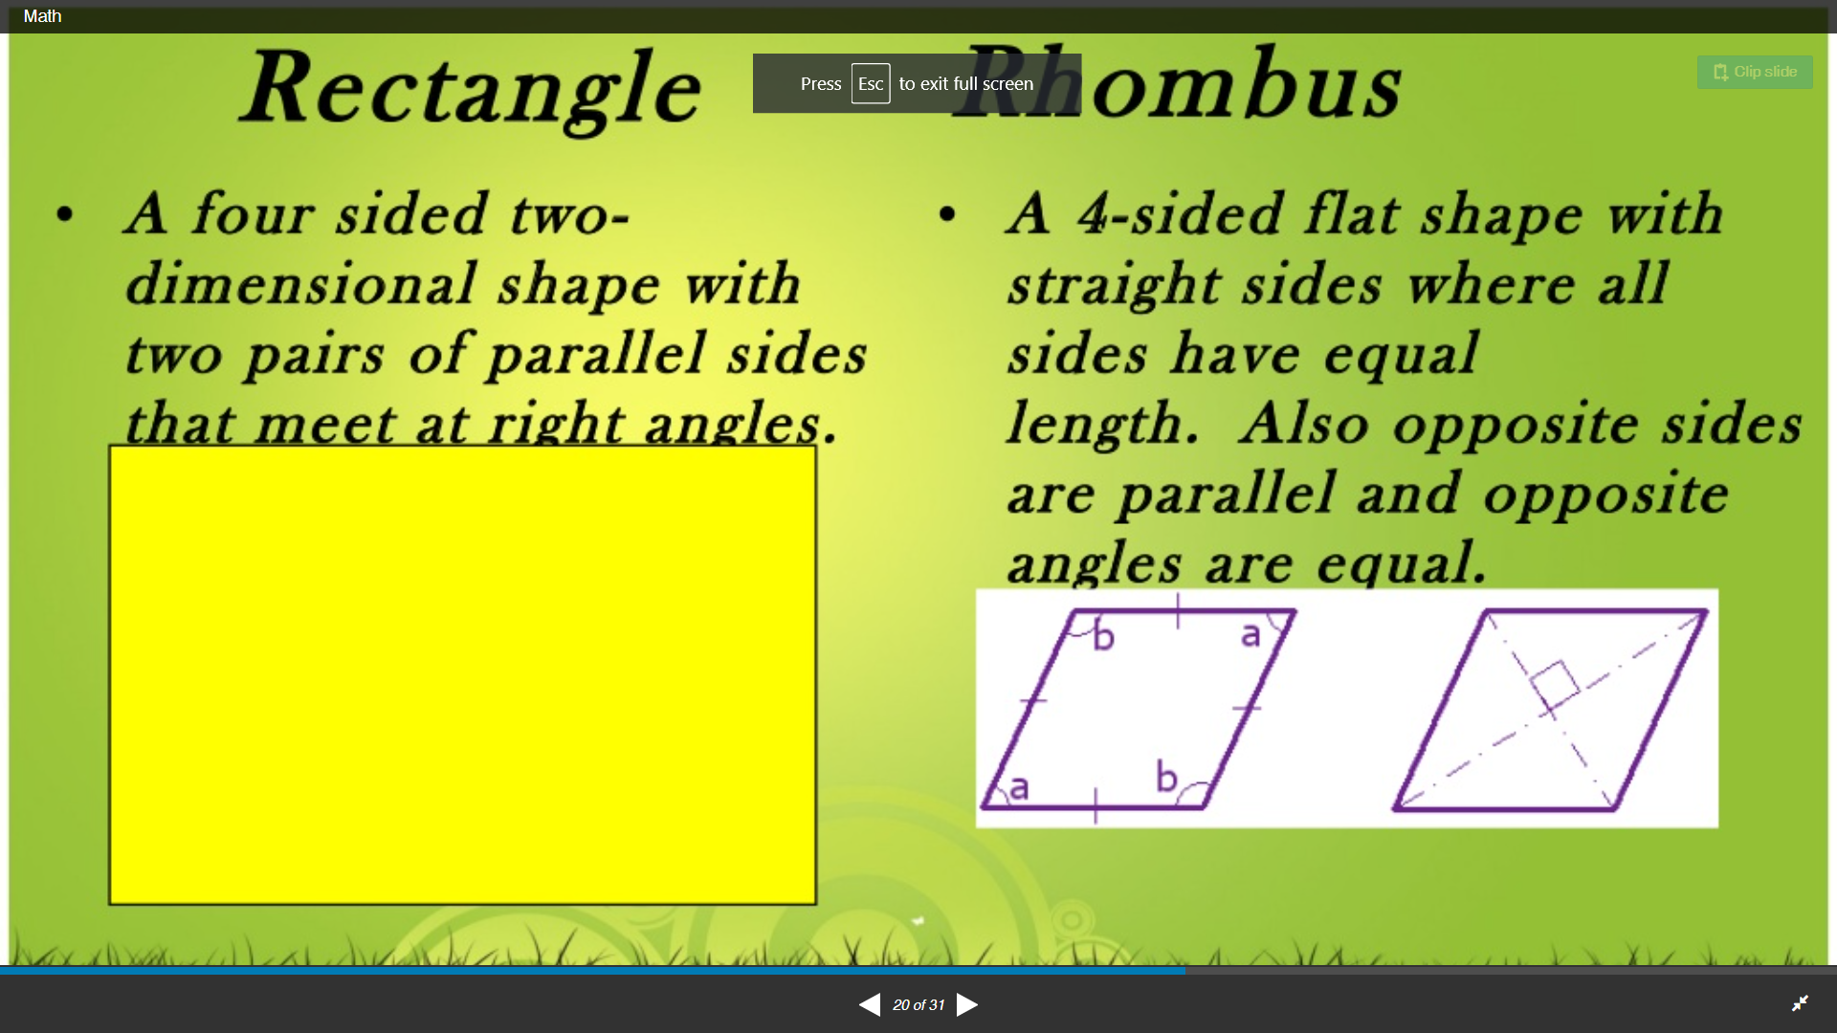

Slide 10
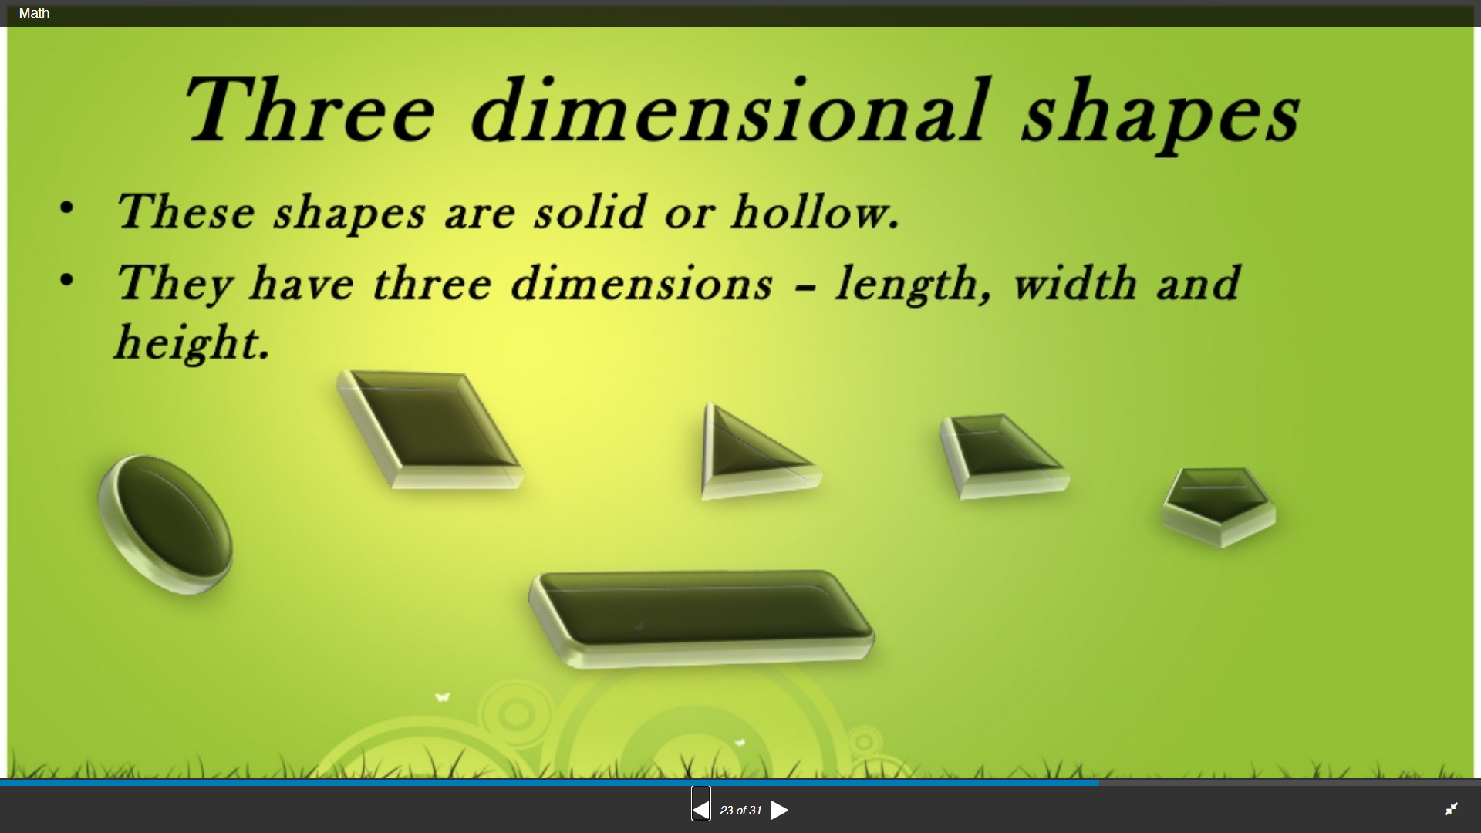

Slide 11
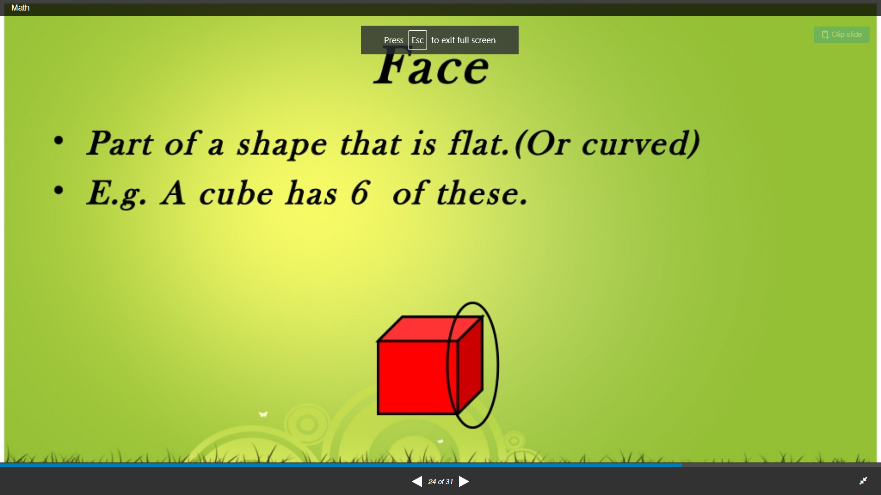

Slide 12
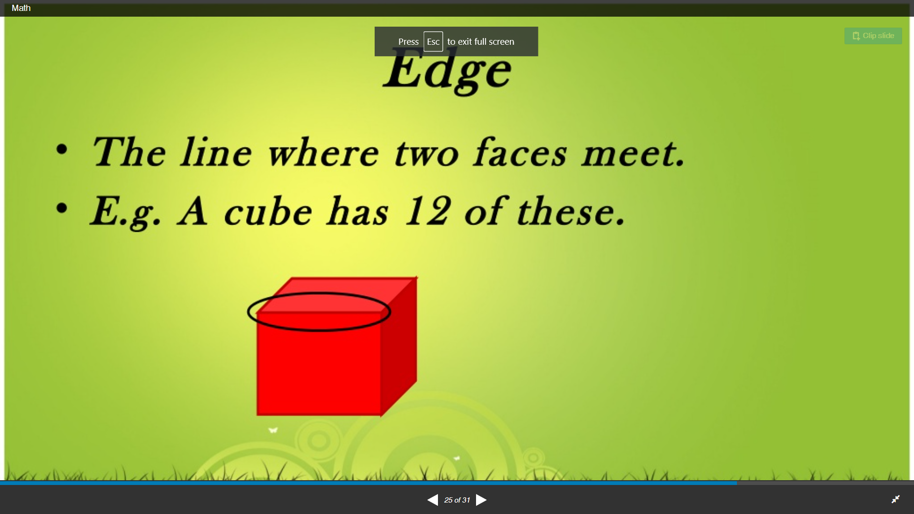

Slide 13
